Slide 1
Credit card default prediction
CAPSTONE PROJECT
Presented By:
Sneha Tandon – University Of Essex – Computer Science and Electronic Engineering (CSEE)

Slide 2
OUTLINE
Problem Statement (Should not include solution)
Proposed System/Solution
System Development Approach (Technology Used)
Algorithm & Deployment
Result
Conclusion
Future Scope
References

Slide 3
Problem Statement
This project is aimed at predicting the case of customers' default payments in Taiwan. From the perspective of risk management, the result of predictive accuracy of the estimated probability of default will be more valuable than the binary result of classification - credible or not credible clients. We can use the K-S chart to evaluate which customers will default on their credit card payments.

Slide 4
Proposed Solution
The proposed system aims to address the challenge of predicting the defaulters of credit cards. This involves leveraging data analytics and machine learning techniques to forecast demand patterns accurately. The solution will consist of the following components:
Data Collection:
Gathered data on the sex, marriage, kids, education, limited balance, and how much they need to pay and they paid.
There is column default pay next month which shows [1 = yes, 0 = no].
Data Preprocessing:
The data preprocessing techniques used are handling missing values, encoding categorical variables, feature scaling, feature selection, handling class imbalance and handling outliers.
Machine Learning Algorithm:
Implement a machine learning algorithm, such as Logistic Regression, SVC, Random Forest, Decision Tree and XGBoost.
Deployment:
The algorithm giving the highest accuracy is chosen for this.
In other words, the best performing model is chosen.
Evaluation:
Assess the model's performance using appropriate metrics such as Confusion Matrix, Accuracy Score, ROC Curve and AUC and Cross-Validation.
They provide insights into how well the models can distinguish between defaulters and non-defaulters and help in selecting the best-performing model for deployment.
Result: XGBoost has a most accuracy of 0.82.

Slide 5
System Approach
The "System Approach" section outlines the overall strategy and methodology for developing and implementing on the credit card defaults prediction system. Here's a suggested structure for this section:
System requirements
Library required to build the model

Slide 6
System requirements
Hardware:
Processor: intel core i5 or higher.
RAM: 8 GB or higher.
Storage: 256 GB or higher (SSD).
Software:
Operating System: Windows 10, macOS or Linux.
Python: Version 3.6 or higher.
Integrated Development Environment (IDE): Jupyter Notebook, PyCharm, or any preferred Python IDE.

Slide 7
Library(s) required to built the model
NumPy
Pandas
Matplotlib and Seaborn
Scikit-learn
XGBoost
LightGBM
Imbalanced-learn
Sklearn.preprocessing
Pandas.get_dummies
Sklearn.metrics
Sklearn.model_selection

Slide 8
Algorithm & Deployment
In the Algorithm section, describe the machine learning algorithm chosen for predicting bike counts. Here's an example structure for this section:
Algorithm Selection:
The algorithms considered were Logistic Regression which is used for binary classification tasks and as it has abilities to handle both numerical and categorical features.
Then Decision Trees and Random Forest also have the ability to handle both numerical and categorical data by making tree like models and help make predictions.
XGBoost is also used as it has the ability to handle imbalanced datasets.
Data Input:
Age, gender, education level, marital status, income, credit limit, payment history, outstanding balance, payment status, past due amounts, transaction patterns and number of dependents.
Training Process:
Data preprocessing (handling missing values), model training (fitting the selected algorithm and using techniques likes random search with cross-validation), and model evaluation (evaluation the trained model’s performance on the testing set using accuracy, precision, and confusion matrix).
Prediction Process:
Predictions on the new credit card data can be made once this model is trained and validated.
Same procedure for the data preprocessing needs to be done on the new data that needs to be input data into the trained model getting the probabilities for the new set as well.

Slide 9
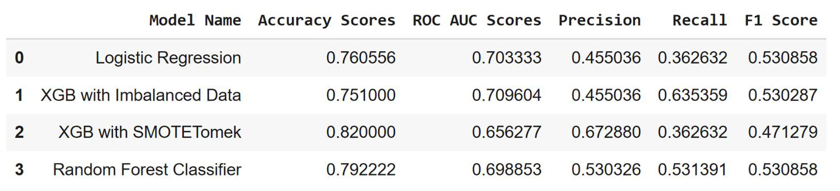
Result
I have trained and evaluated many machine learning models for the credit card default predictions. The models were trained on a dataset which was pre-processed and split into training and testing sets. Various evaluation metrics are used to check the performance of the models. The best performing model was XGBoost, which achieved an accuracy of 0.82 and a precision of 0.67288 with SMOTETomek.

Slide 10
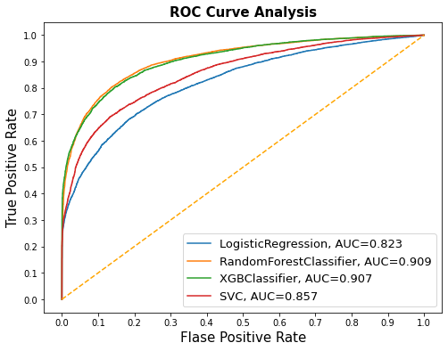
… continuation
this is the AUC and ROC Curve which indicates it is 0.85
and the model has a strong ability to discriminate
between defaulters and non-defaulters.

Slide 11
… continuation
The table shown on the slide 9, highlights that XGBoost outperforms Logistic Regression and Random Forest in terms of accuracy, precision, and AUC, making it the preferred choice for this model. However, it is only effective when done with SMOTETomek which has a very low recall value.

Slide 12
Conclusion
In conclusion, this project aims to develop a machine learning model for credit card default prediction and after exploring various algorithms, I have found that the XGBoost model demonstrates the best performance in predicting the defaults. The model’s AUC of 0.85 further highlights how it distinguishes between the defaulters and non-defaulters. The least accurate method was XGBoost with Imbalanced Data and Logistic Regression. However, the XGBoost with Imbalanced Data gives the best recall of 0.635359. The higher recall can be achieved if low precision is acceptable. It can also be said that keeping in mind about the recall, Random Forest Classifier can provide us the best results as XGBoost with SMOTETomek lacks recall which is crucial in classifying the defaulters.

Slide 13
Future scope
The future scope of credit card default prediction using learning is quite promising and offers various avenues for further research and development. More advance machine learning techniques can be used like deep learning models which could potentially improve the predictive performance. Additionally, more sources for data can be used like credit bureau data, social media data or even macroeconomic indicators as well. This would give more comprehensive view on the customer’s creditworthiness. The further changes I can do to improve the entire model is to implement the streaming data processing and online learning algorithms could allow the model to adapt to changing customer behaviors and market conditions in near real-time. Furthermore, to increase the transparency and trust in the decision-making process techniques like feature importance analysis, methods like LIME, SHAP can be used.

Slide 14
References
IEEE referencing is used:
“EDA and Logistic Regression,” kaggle.com. https://www.kaggle.com/code/fegadeharish/eda-and-logistic-regression/notebook
anishjohnson, “Credit_Card_Default_Prediction/Credit_Card_Default_Prediction- Anish Johnson-Presentation.pdf at main · anishjohnson/Credit_Card_Default_Prediction,” GitHub, 2022. https://github.com/anishjohnson/Credit_Card_Default_Prediction/blob/main/Credit_Card_Default_Prediction-%20Anish%20Johnson-Presentation.pdf
“Google Colaboratory,” colab.research.google.com. https://colab.research.google.com/github/CodeWithSridhar/Credit_Card_Default_Prediction/blob/main/Credit_Card_Default_Prediction_Capstone_Project.ipynb#scrollTo=e--YIm0Twg2y
“Credit_Card_Default_Prediction/Credit_Card_Default_Prediction_Capstone_Project.ipynb at main · CodeWithSridhar/Credit_Card_Default_Prediction,” GitHub. https://github.com/CodeWithSridhar/Credit_Card_Default_Prediction/blob/main/Credit_Card_Default_Prediction_Capstone_Project.ipynb
“Credit Card💳 Default Prediction,” kaggle.com. https://www.kaggle.com/code/bansodesandeep/credit-card-default-prediction#Evaluating-the-models
R. Polanitzer, “Machine Learning for Default of Credit Card Clients in Taiwan,” Medium, Feb. 03, 2022. https://medium.com/@polanitzer/machine-learning-for-default-of-credit-card-clients-in-taiwan-7336c79b5158

Slide 15
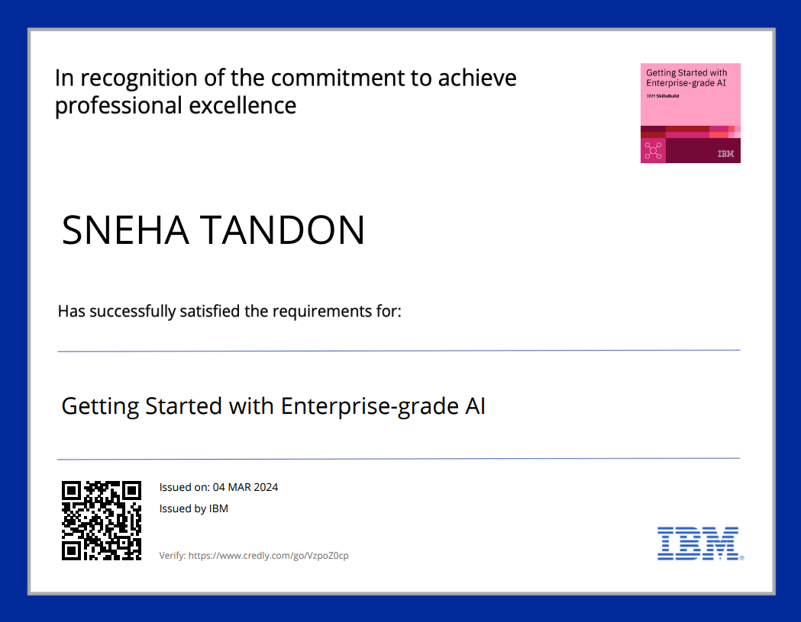
course certificate 1

Slide 16
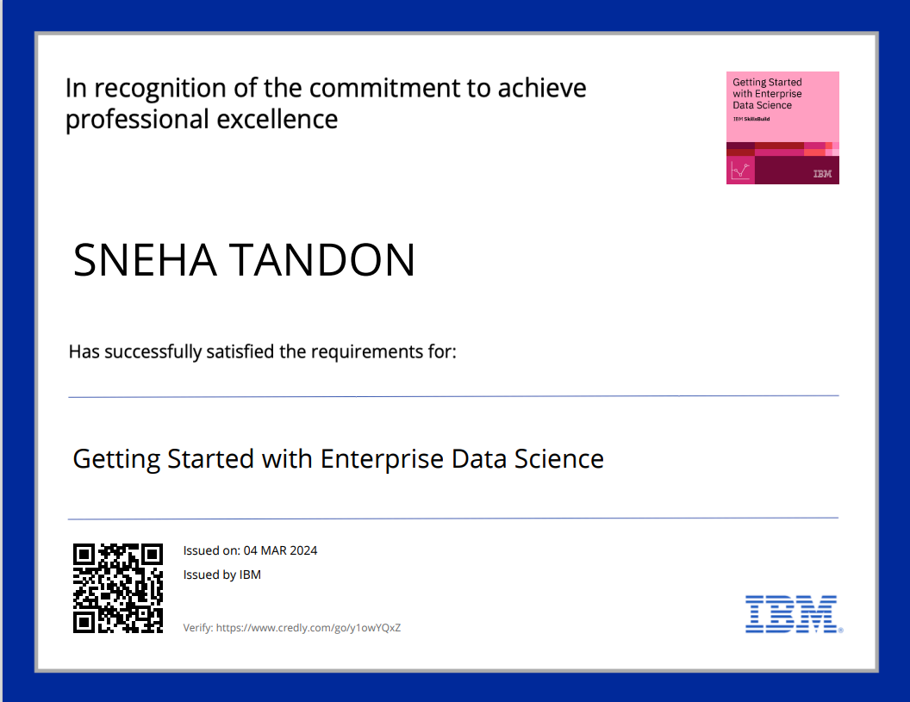
course certificate 2

Slide 17
THANK YOU

